Slide 1
What to Keep & What to Change: Artistic Critique for Self and Peer Assessment
Pete Edwards Madison Central High School
Visual Art
EKUWP 2012 Summer Institute
June 13, 2012

Slide 2
Instructional Breakdown of Mr. Edwards’ Art Classes (Full Disclosure)

Slide 3
“Sometimes the artist is not fully aware of what has been wrought and the full implications of the work. The ethics of art criticism must stem from a base of honesty and integrity….” -James J. Kelly
Kelly, James J. (1981). The Sculptual Ideal (3rd ed.). Prospect Heights, IL: Waveland Press

Slide 4
Why We Critique
Reflect on what you have done
Reflect on what others have done
Which in turn, makes you

Slide 5
In Practice
Visual Art I
Check for content knowledge
Examine growth opportunities
Advanced Art
Reflect on Process and Product
Assess/Reflect on peer work

Slide 6
Critiquing Art from Outside the Classroom
Work as a group (at tables)
Discuss/write down your answers
Share your interpretations
Discuss as a class

Slide 7
Rules for Critique
Any response is VALID if:
It is respectful
It is appropriate
It refers directly to the artwork
You can support it

Slide 8
Seonna Hong Self Defeating
2006
Acrylic on canvas
24 x 30 inches

Slide 10
Symbols vs. Real
Draw a “Flower”
Your brain gets in the way
You get a symbol
See a flower with your eye
Draw a flower with your hand
Cut your brain out of the equation
You get a flower
Or something close(r)

Slide 11
Blind Contour Critique
What you liked/Why
Talk about the Product
What you would change/How
Share it with someone at your table
Talk about the Process

Slide 12
Good Work! Now here’s what it looks like over a longer timeline.

Slide 13
Not a
Tea Pot
(Advanced Art)

Slide 14
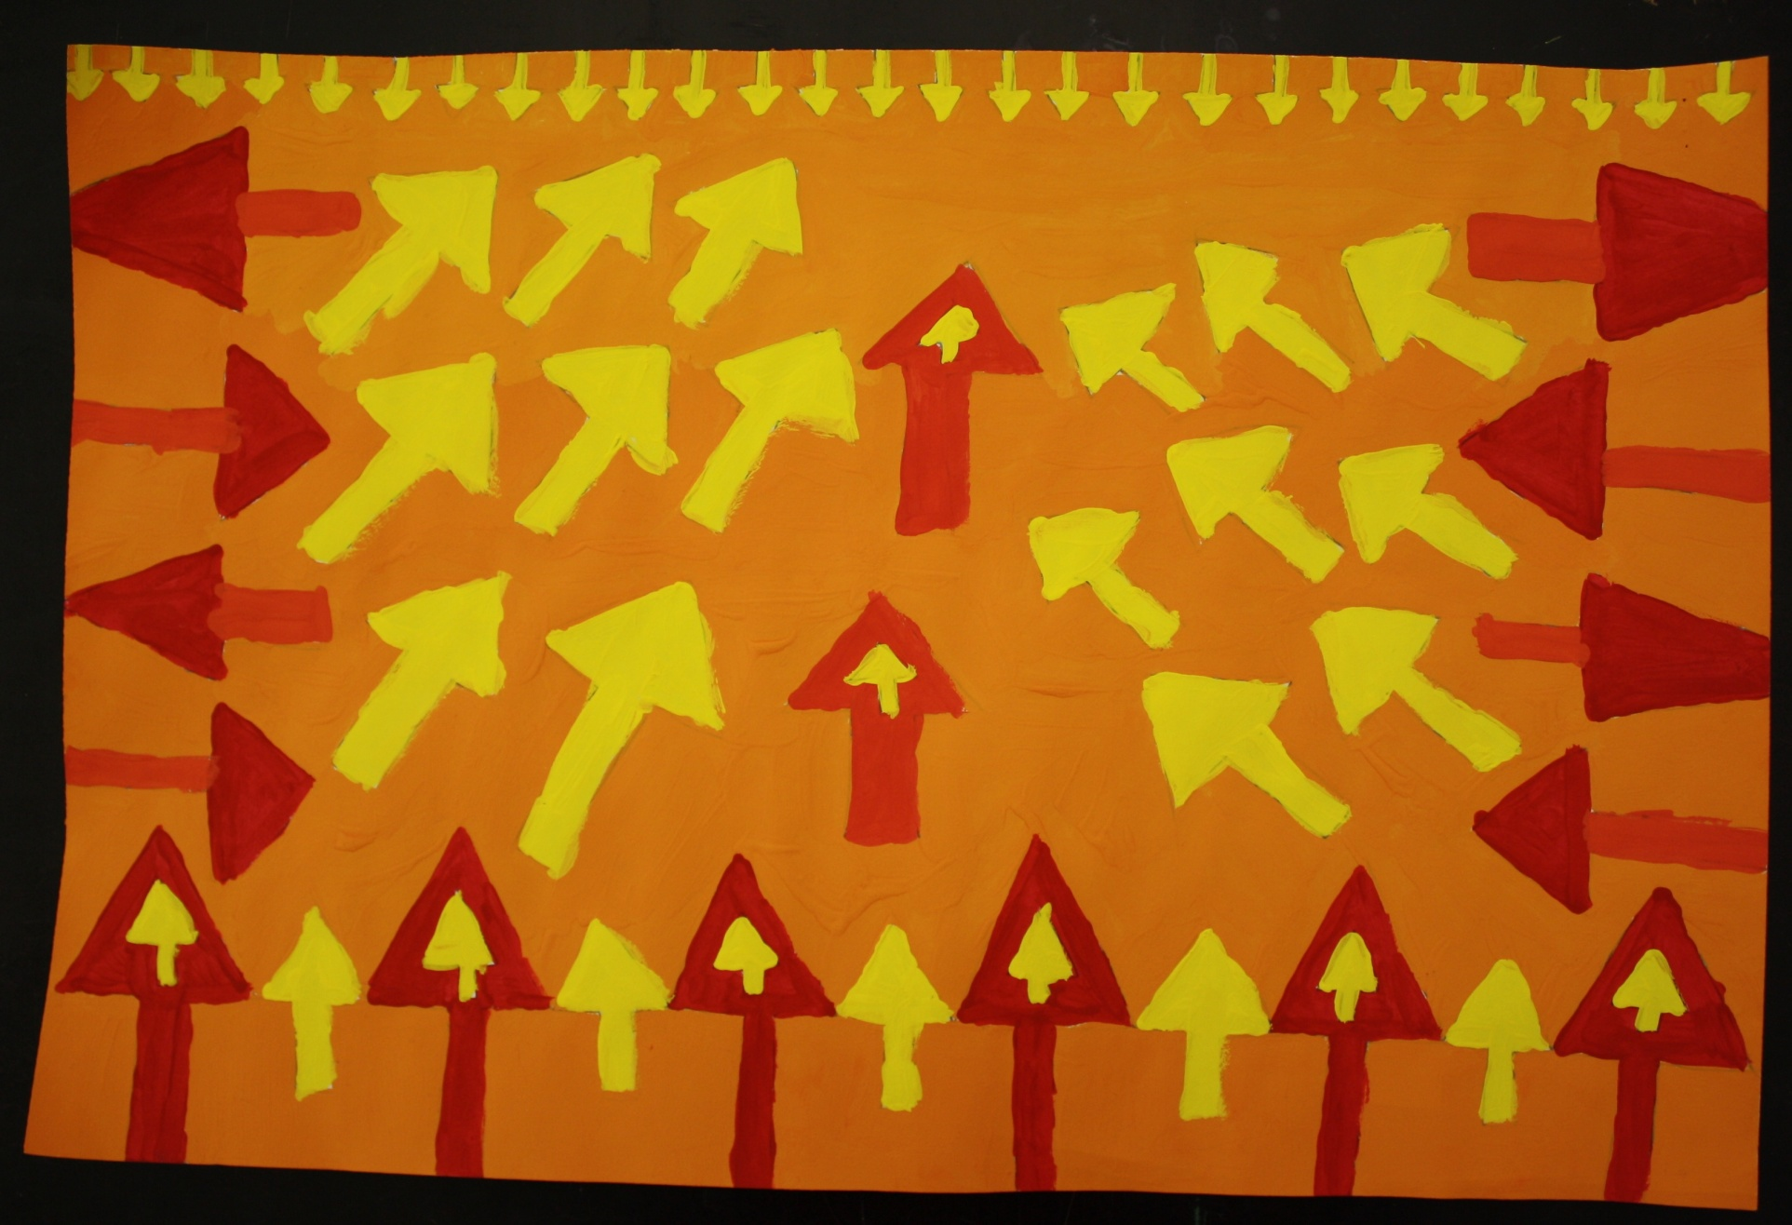
Repeated Shape Painting (Visual Art I)

Slide 15
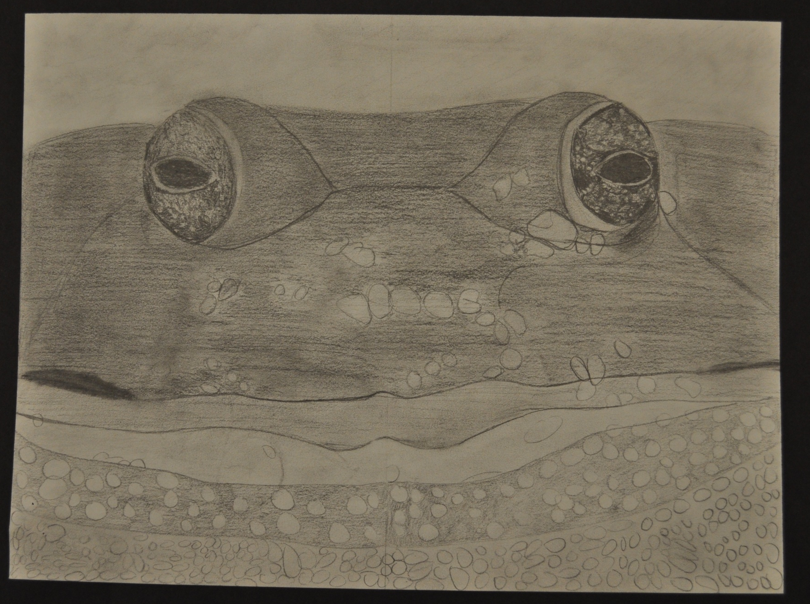
Value Grid Drawing (Visual Art I)

Slide 16
The interpretation of art is not mere fantasizing, but depends on powers of analysis which are improved by practice, like any other skill.
-Terence Grieder
Grieder, Terence. (1990). Artist and Audience. Orlando, FL: hold, Rinehart and Winston, Inc.

